Slide 1

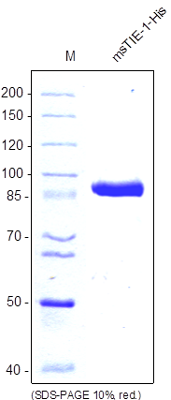
Reliatech GmbH
Mouse soluble TIE1-His (Insect cells)
(Cat# S01-041 / S01-042))
Figure 1: SDS-PAGE analysis of recombinant mouse sTIE-1 produced in insect cells. Sample was loaded in 10% SDS-polyacrylamide gel under reducing conditions and stained with Coomassie blue.
http://www.reliatech.de / orders@reliatech.de

